Slide 1
nexVortex Introduction
April 19th 2019
Mike Nowak, VP Sales
mnowak@nexVortex.com
616.259.0601
www.nexVortex.com

Slide 2
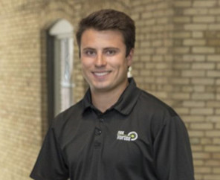
Key Contact – Local Pre-Sales
Mitch Kahl,
Northeast Channel Account Manager
You can contact him at
mkahl@nexvortex.com or 616.259.0609
'

Slide 3



Key Contacts
Mitch Kahl, Northeast Channel Account Manager (Grand Rapids, MI)
You can contact her at mkahl@nexvortex.com or 616.259.0609
Marc Mora, Partner Development Coordinator (Grand Rapids, MI)
You can contact him at mmora@nexvortex.com or 616.259.0610
Michael Nowak, Vice President of Sales (Grand Rapids, MI)
You can contact him at mnowak@nexvortex.com or 616.259.0601

Slide 4
Agenda
Introduction & Pre-Sales Resources
SIP Trunking Overview
nexVortex Managed Hosted Voice
Q&A

Slide 5
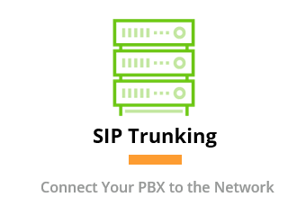
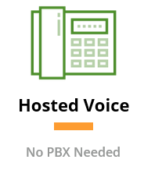
nexVortex Key Services
QAV

Slide 6
nexVortex Key Services
Q
uality

Slide 7
nexVortex Key Services
A
vailability

Slide 8
nexVortex Key Services
V
isibility

Slide 9
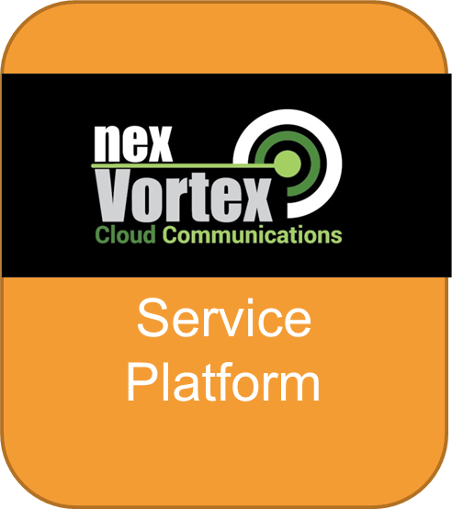
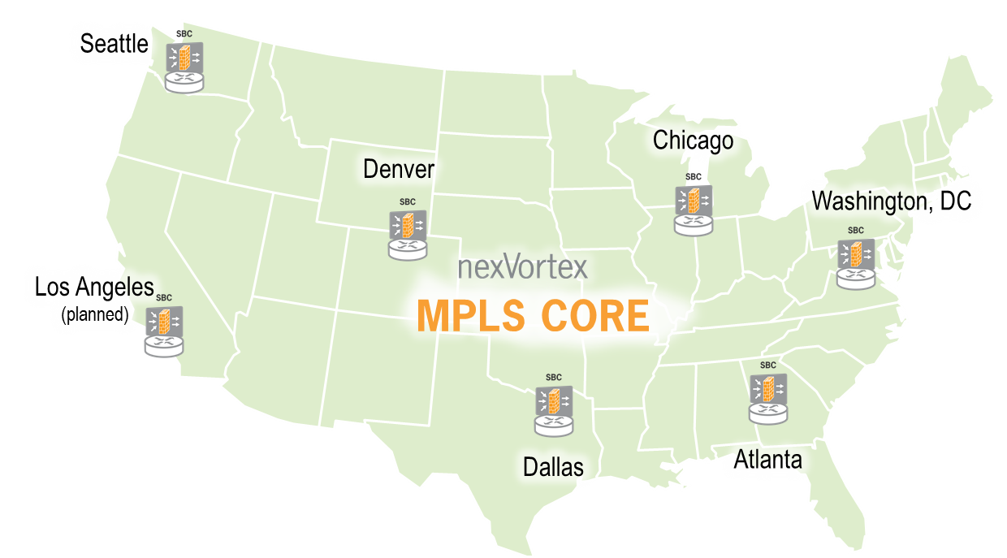
nexVortex Infrastructure
Call Processing
Real Time Portal Tools
Real Time Billing
Auto Detecting DR

Slide 10
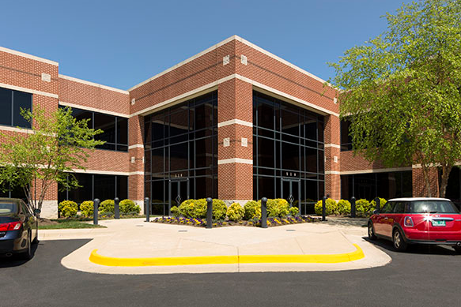
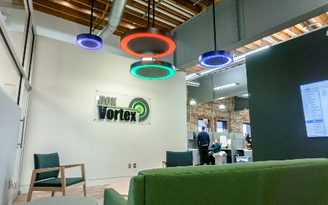
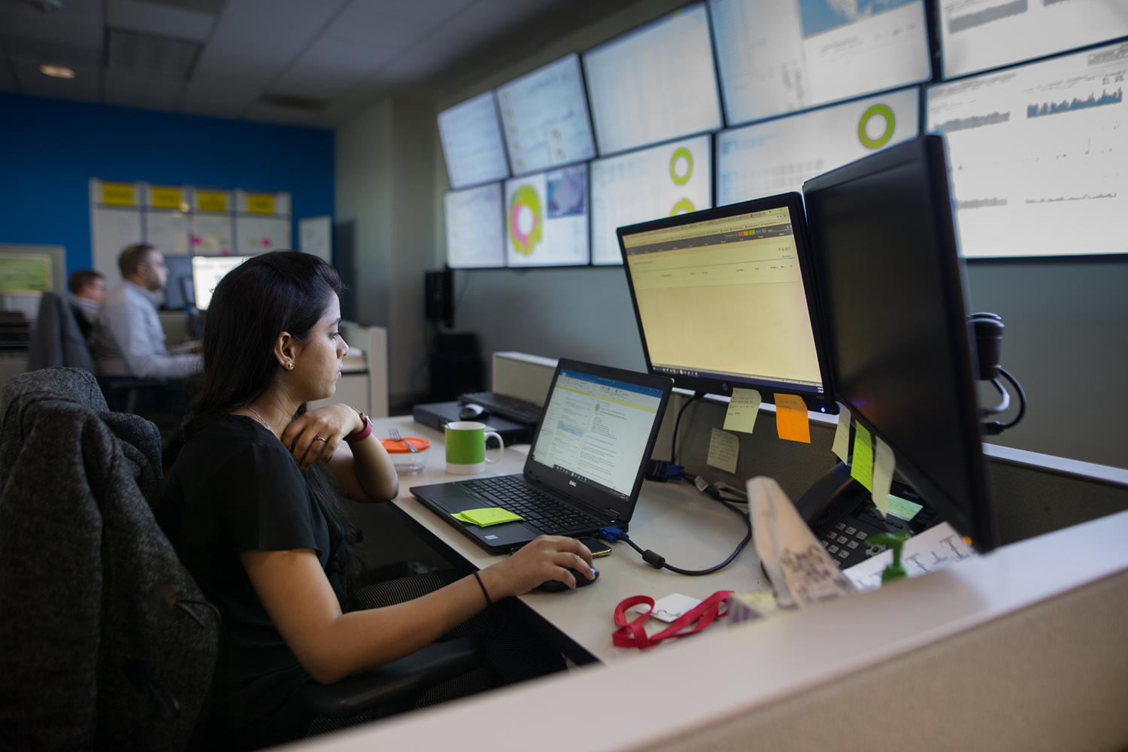




Company Snapshot
13 years delivering commercial service
Our customer experience team - all certified
Local channel account management personnel in key cities across the US to help you sell

Slide 11
nexVortex
Get to Green Provisioning
Coordinate with Channel Partners Expectations
Service Verification
Fast Efficient Porting Process
Customer Training
Billing Review and Follow up
Pre-Sales Support
Dedicated Project Coordinator
Post Sales Follow Up, Audits, Heatmaps

Slide 12
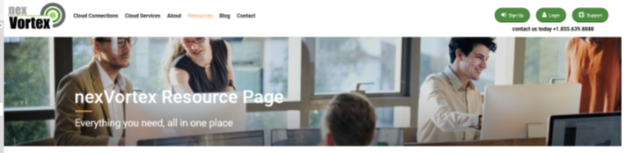
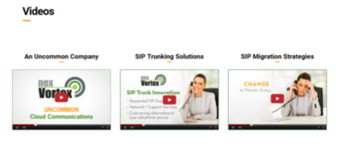
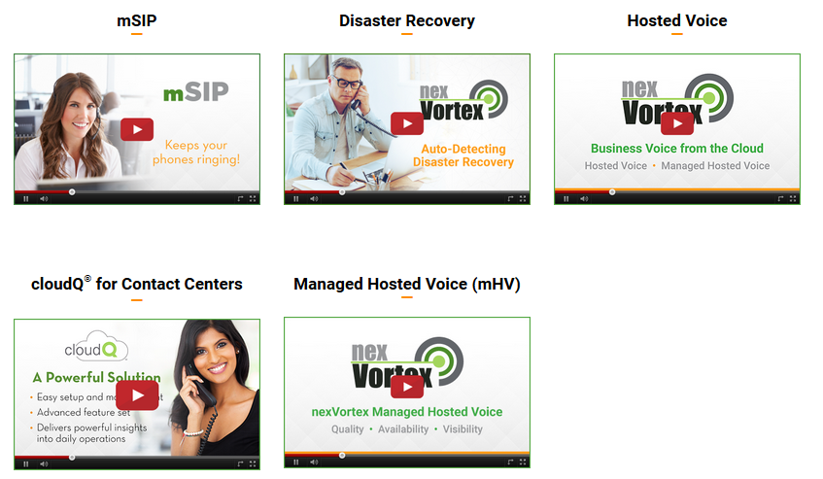
Video Resources

Slide 13
nexVortex SIP Trunking
Mike Nowak, VP Sales
mnowak@nexVortex.com
616.259.0601
www.nexVortex.com

Slide 14
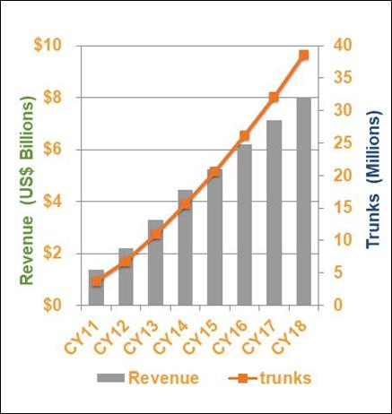
SIP Trunking Expansion
Adoption across all sizes of business
Larger enterprises are not
implementing 100% cutover on day-one
$8.0 billion worldwide by 2018
2013–2018 5-year CAGR of 19%
Estimated that 700,000 analog lines are disconnected every month

Slide 15
nexVortex
SIP Trunking Value
Todays Standard
Cost Savings
Superior Flexibility
Superior Redundancy
Multiple Connectivity Options
Remote Phone E911
Auto Detecting Disaster Recovery
Top SIP Trunking Applications
      PRI and Analog Line Replacement
Replacement of “SIP is just SIP” Implementations
Multi-Site Solutions
Remote Phone Applications
Toll Free Contact Centers

Slide 16



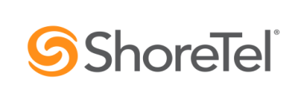









SIP Trunking PBX Interoperability
Interoperable with Most Systems
Adtran 908E with PRI handoff
Adtran 3140 SBC

Slide 17

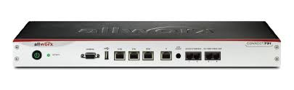
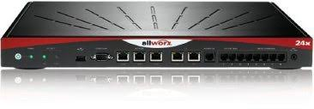
Use Case: Multisite Environments
What about sharing resources and reducing trunk spend?
56 Designated Call Paths
What about disaster recovery for a down site?
What about remote phone E911?
PRI - 23 Channels
PRI - 23 Channels
10 Lines
Site 1
Site 2
Site 3

Slide 18


Use Case: Shared Trunk Resources
Reduce trunk subscriptions by 33% (avg)
E911
E911
E911
E911
SIP or PRI handoff
SIP or PRI handoff
SIP or PRI handoff
Trunk Resources Shared
Avoid Under utilization Waste
Share Resources on Demand
Auto Detecting Failover

Slide 19


nexVortex – Auto Disaster Recovery
Autodetecting Disaster Recovery
Included Free with Every SIP Account
X
X
X
Value Points
Disaster recovery rules can be preset by individual DN or Toll-Free Number
IP address or phone number and managed through our easy-to-use-portal

Slide 20
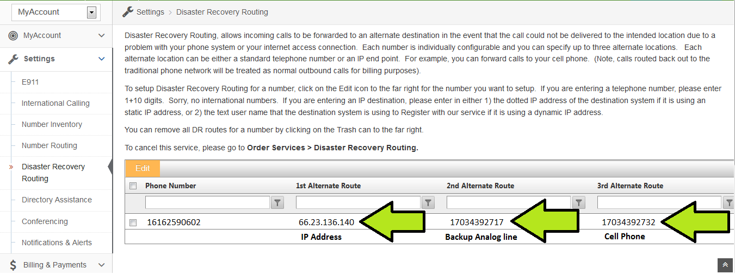
Auto Detecting Disaster Recovery
Auto Detecting Preset Failover Web Portal Control Failover to Phone #’s or IP Addresses

Slide 21



Toll Free Service –With Failover
nV Auto Failover to
Alternate connection
(PRI number, IP Address, etc)
nexVortex Network
855.639.8888
Internet Access
PRI

Slide 22
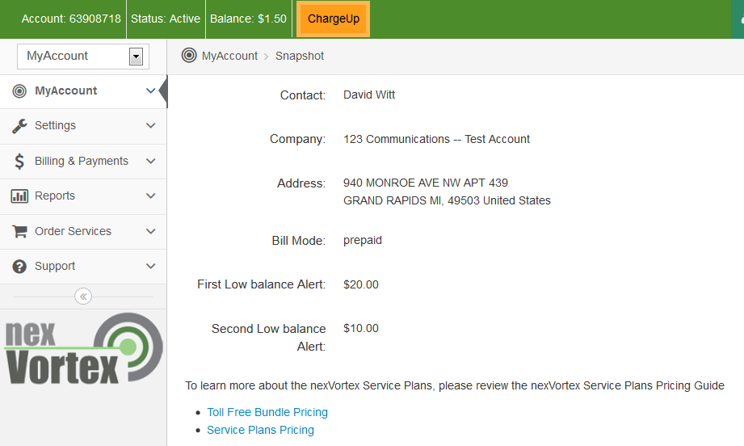
Portals
The nexVortex Portal: Feature Rich, Easy to Use, Real Time Control
Customer Portal
Sub Agent/Partner Portal
  nexVortex Customer Portals
  Set Inbound Routes
  Disaster Recovery
  Real Time Billing
  CDR Reporting
  Order Services
  International Calling
  Alert Settings
  Sub Agent Portal
  Real Time Changes
  Set Inbound Routes
  Disaster Recovery
  E911 Set Up
  CDR Reporting

Slide 23
nexVortex mSIP
(Managed SIP Trunking)
Mike Nowak, VP Sales
mnowak@nexVortex.com
616.259.0601
www.nexVortex.com

Slide 24








nexVortex Peering Relationships

Slide 25
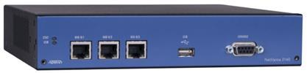

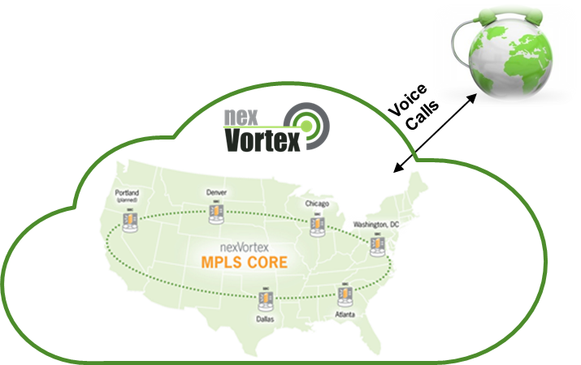
mSIP Dual WAN – Business Continuity
If the primary ISP circuit goes down, voice & network traffic can be sent and received over an alternative connection.
nexVortex Provides ADTRAN 3140
Can be configured for Dual WAN
(ADTRAN can also take a PRI handoff from PBX and convert to SIP)
ISP #1
ISP #2
Load balancing and prioritization can be set according to customer’s preferences at installation time

Slide 26

mSIP Redundancy
nV provides an ADTRAN
preconfigured for all mSIP Service Nodes
If an mSIP Service Node is down, the ADTRAN
moves calls to other mSIP Service Nodes
mSIP Node
Customer
mSIP Node
mSIP Node
mSIP Node
mSIP Node
Adtran

Slide 27
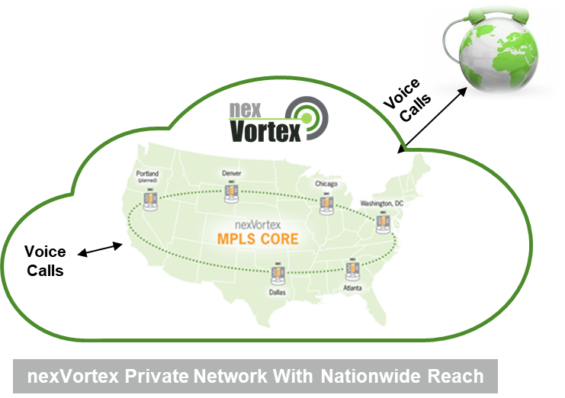


mSIP Connectivity Options
Customer Network
Access Network
Wide Area Network
Customer
LAN
Use Existing
ISP
ADTRAN
(nexVortex Provided)
PBX
Upgrade to a nexVortex
Provided Circuit
1). Use an existing ISP connection(s)
2). Better yet – use an ISP peering connection
3). Even better – use a nexVortex provided internet or MPLS circuit

Slide 28
Hybrid Connectivity
Large Office with
nV Direct Connect
Local E911
Public
Internet
Public
Internet
Small Office
Local E911
Remote Phone
Local E911

Slide 29

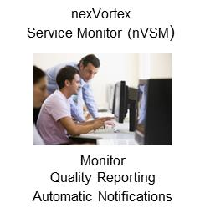

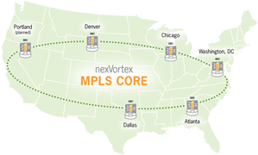
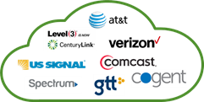
Managed SIP (mSIP)
mSIP Delivers Voice Quality with Definitive Trouble Shooting
Voice Quality Measured
Along Call Path
Voice
Calls
Voice Calls
Marked
For QoS
Voice Calls
PBX
ADTRAN
Direct Peering
Customer Premise
Access
nexVortex Private Network With Nationwide Reach
Calls marked for QoS & measured at multiple points
Direct peering means less hops, better quality
Private MPLS core enforces QoS all the way to the PSTN
Call by call quality stats collected, monitored, reported
Conclusion:
Quality Measured, Reported, Proven
Definitive Troubleshooting
No Finger Pointing
29

Slide 30
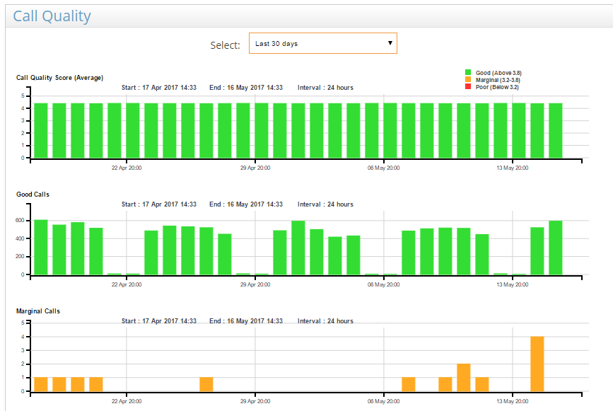
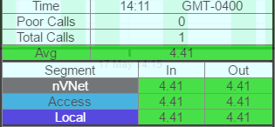
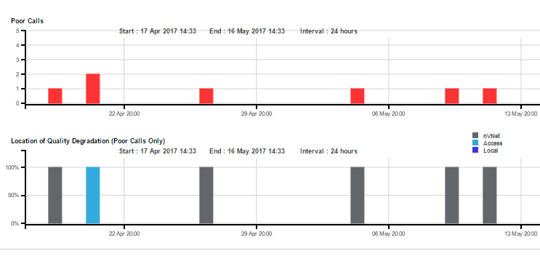
nexVortex Service Monitor - nVSM
How did calls score?
Individual call quality reporting
Where did issues occur?

Slide 31
How Much is a SIP Trunk?
Unlimited Minutes or Burstable?
Single Site?
Multi-Site?
Multi-PBXs?
Want ISP Peering or Circuit with CoS?
Want Definitive Troubleshooting?
Want PRI Handoff?
What about Surcharges?

Slide 32

SIP Service Plans
mSIP
$329 per mo
Add Channels
as needed
mSIP
$329 per mo
Add Channels
as needed
mSIP
$329 per mo
Burstable SIP
$139 per mo
SIP
$99 per mo
Company Size

Slide 33
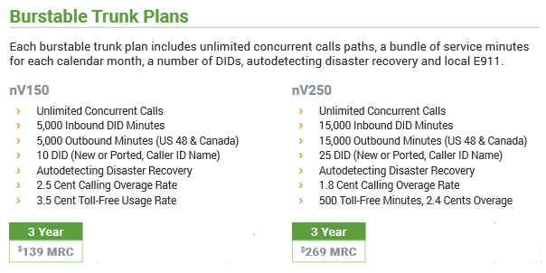
Burstable Plans

Slide 34
mSIP Pricing
mSIP Base Package
Channels
23
$14.99 per Additional Channel
SBC
Adtran Rental Included
PRI Delivery Option Available
Inbound DID Calling
Unlimited Calling
Unlimited Minute Option Available
Outbound Calling
3,000 Minutes Included, 1.8 Overage
Auto Detecting DR
Included
3 Years
2 Years
$329.99
1 Year
Monitoring & Alerts
Included
$359.99
$399.99
23 DIDs & 1 Toll Free Number are Included
Internet Access is Customer Provided
or can be Ordered from nexVortex

Slide 35
mSIP Base 12 – Metro Markets
mSIP Base 12
Channels
12
3 Year
SBC
Adtran Rental Included
$299.99
Inbound DID Calling
Unlimited Calling
Outbound Calling
Unlimited Calling
Sip or PRI handoff
Includes Free Calling
Auto Detecting DR
Included
Monitoring & Alerts
Included
20 DIDs & 1 Toll Free Number are Included
Internet Access is Customer Provided
or can be Ordered from nexVortex

Slide 36
PRI vs mSIP
Standard PRI
What about DR? / Dual Connections?
mSIP Plan
What about more channels?
What about a 2nd PBX
or 2nd Location?
What about Remote
Phone E911?
mSIP Network
23 Channel PRI
$299 - $399
mSIP Network
What about Visibility, Portal
Tools and Control?
23 Channel mSIP
$329
What about Speed to Deployment?

Slide 37
nexVortex
SIP Trunking Value for Partners
Every Order is a Zero Fail Mission
Cloud Attributes for Phone Systems
Centralized Management
Less Downtime
Same Day Provisioning

Slide 38
nexVortex Hosted Voice

Slide 39
Hosted Voice Introduction
nV pairs Value with Reliability and Quality
Easy to use and Deploy
nexVortex Hosted Voice
nexVortex owns and operates its own platform
All Features Included for $19.99 per seat
Contact Center Seat included
Managed Hosted Voice(mHV) for Single WAN or Dual WAN can be added
Mobile App Included
Simple All Inclusive Pricing Model
mHV for Voice Quality
Rent or Bring your Own Phone

Slide 40


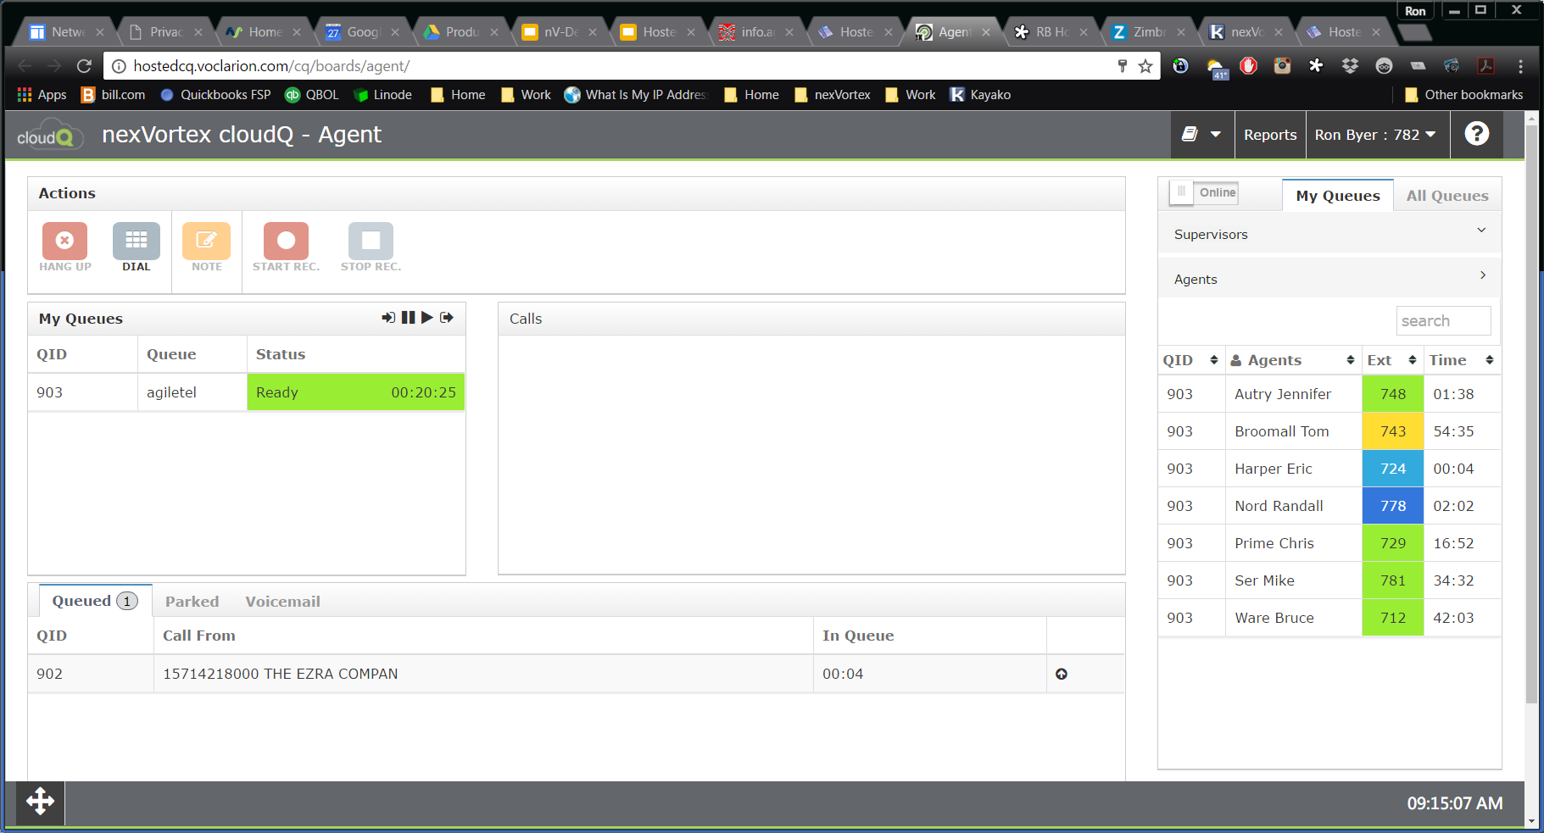





One Price – All Features Included
Choose Either Traditional Unlimited
Minute Seats or Contact Center Seats
for the Same Price

Slide 41
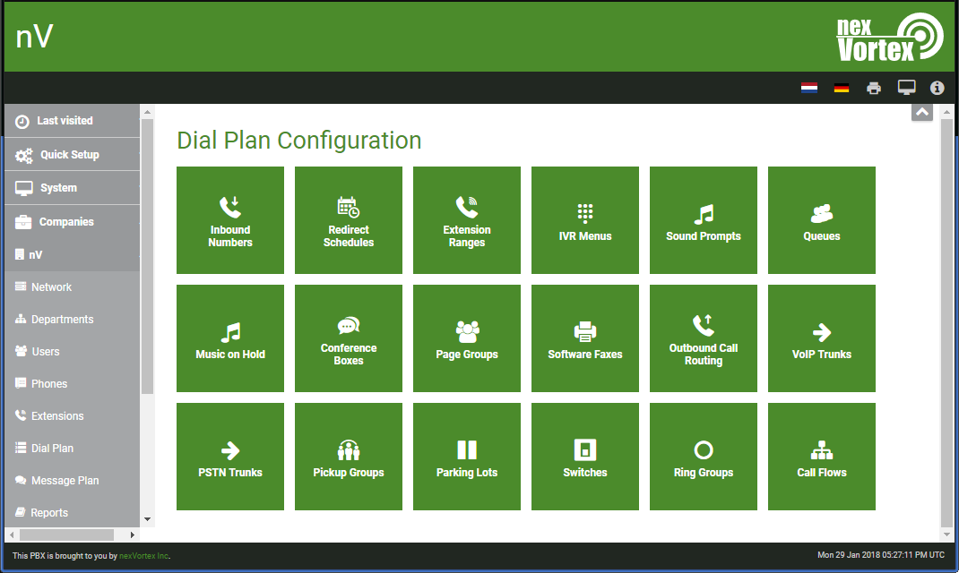
Customization at your Finger Tips
Customize your own Dial Plan or call nexVortex for Moves, Adds, Changes
Call Flow Preferences
Inbound Numbers
Auto Attendant Script
Ring Groups

Slide 42
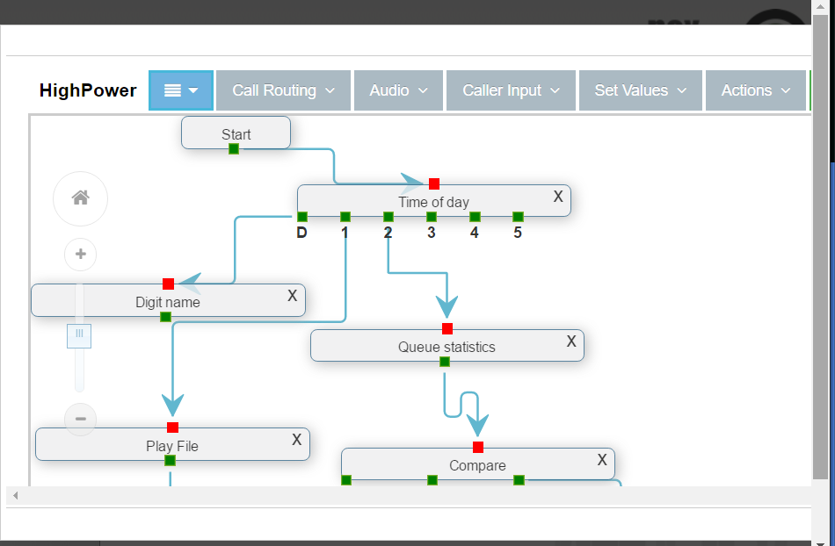
Customization at your Finger Tips
The IVR editor provides the ability for partners and customers to visually create a custom call flow for inbound call handling

Slide 43

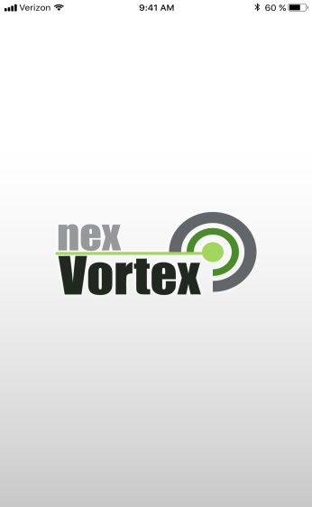
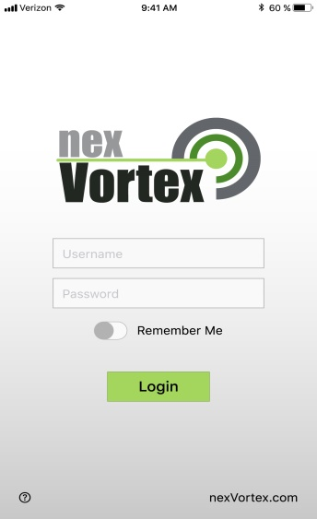

Mobile App for Hosted Voice
Splash Screen
Login

Slide 44
Mobile App
nexVortex Mobile App included
Preserves battery life
Uses Cellular minutes, not data

Slide 45
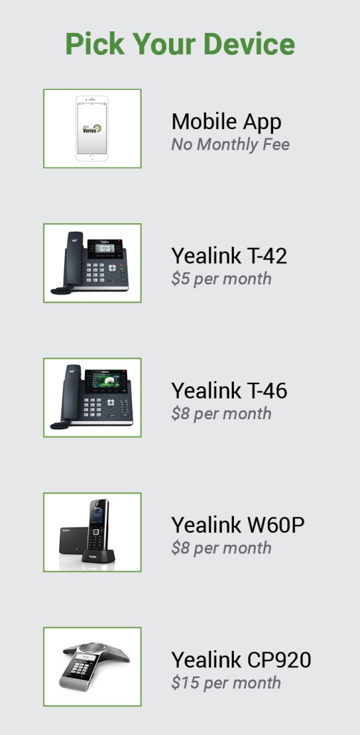
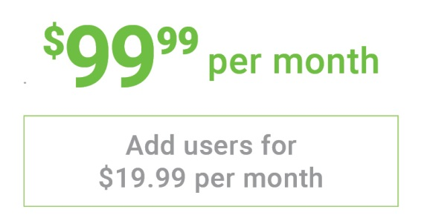
Unlimited Minute Seat Pricing
Hosted Voice Seats
5 Seats Included
Easily Add Users
as you Grow
Use a Desk Phone,
Mobile App, or Both
Pick standard or Contact Center Seats
Free Calling Included
  Inbound DID calling
  Outbound to contiguous 48 and Canada
Add mHV for $35 per month
Add Wireless LTE for $49.99 per month
Per Month Pricing is based on 3 year term

Slide 46
Managed Hosted Voice
Mike Nowak, VP Sales
mnowak@nexVortex.com
616.259.0601
www.nexVortex.com

Slide 47

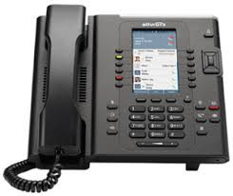
Where is your Hosted Provider?
Providers Data Center(s)
What is the Best Way
to Get from the Cloud to the Ground?
Customer Network

Slide 48
nexVortex Peering Relationships

Slide 49
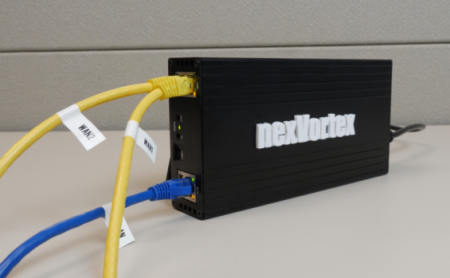



nVE - Details
nexVortex designed, nexVortex software
Supports Up To 100 users per device
Supports 2 ISP connections
Plug-and-play
Managed by nexVortex
Monitoring via nexVortex Service Manager
nexVortex Edge device (nVE)
$35
MRC

Slide 50
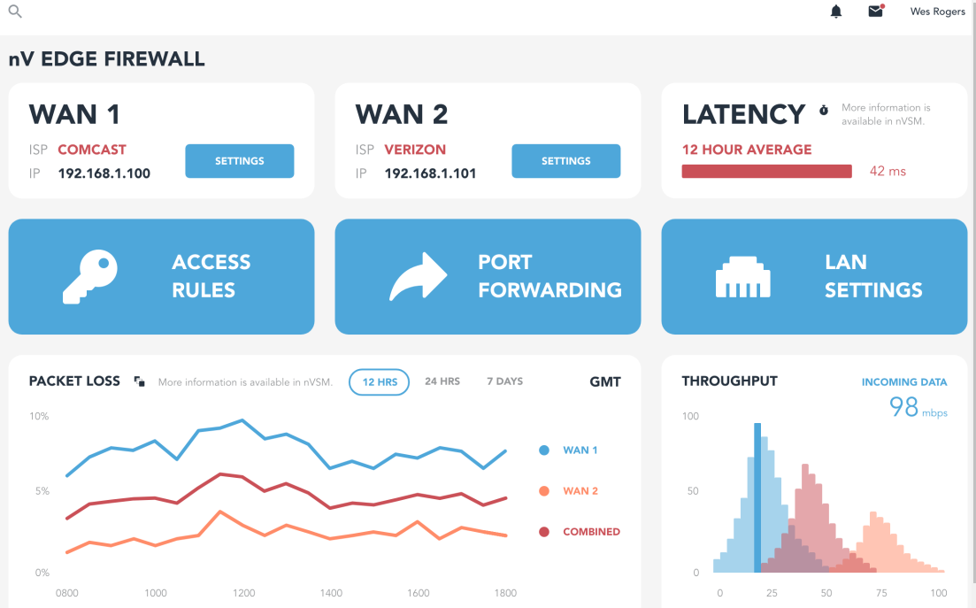
nV Firewall Management
Simple and straightforward. Arrives configured
Centralized -- no need to be there

Slide 51
Edge Concept 1: Replication
Voice packets are replicated across multiple paths
A
mHV
Edge
GW
Patent Pending

Slide 52
The Stats Behind the Solution
Packet
Loss
ISP A
10%
ISP B
20%
A+B
Assumes both ISPs lose the voice packet
!
x
10%
20%
=
2%

Slide 53
Edge Concept 2: Multiple Paths
Patent Pending
GW
Edge
WAN 1
WAN 2
Tunnels Consist of Multiple Paths

Slide 54
Edge Concept 3: Path Escalation
Paths Have Weighted Cost
Paths Are Activated,
Deactivated Automatically Using a Dynamic Escalation Model
Escalation
Time

Slide 55
Use Case – Mission Critical Voice (mSIP)
Customer Network
Access Network
(Public Internet)
nexVortex Network
nexVortex
Data Centers
WAN A
Multiple Voice Paths
Firewall
WAN B / LTE
Dual WAN + LTE Configurations

Slide 56




nexVortex Hosted Voice
Mobile App User
nV MHV
Edge
Remote Phone
User
2nd Office

Slide 57
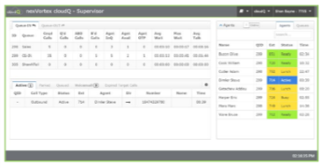
nexVortex Hosted Voice -cQ
Mobile App User
cQ Contact Center
nV MHV
Edge
Remote Phone
User
2nd Office

Slide 58
nexVortex mHV - Hybrid
$35 per Site MRC
nV SDN
Gateway
nV MHV
Edge
Traffic Shaping
ISP Peering
Voice Prioritization
Optional Dual WAN
Remote Phone
User
2nd Office

Slide 59
Questions ?
Mike Nowak
VP Sales
mnowak@nexVortex.com
616.259.0601
www.nexVortex.com

Slide 60
Key Contact – Local Pre-Sales
Mitch Kahl,
Northeast Channel Account Manager
You can contact him at
mkahl@nexvortex.com or 616.259.0609
'

Slide 61
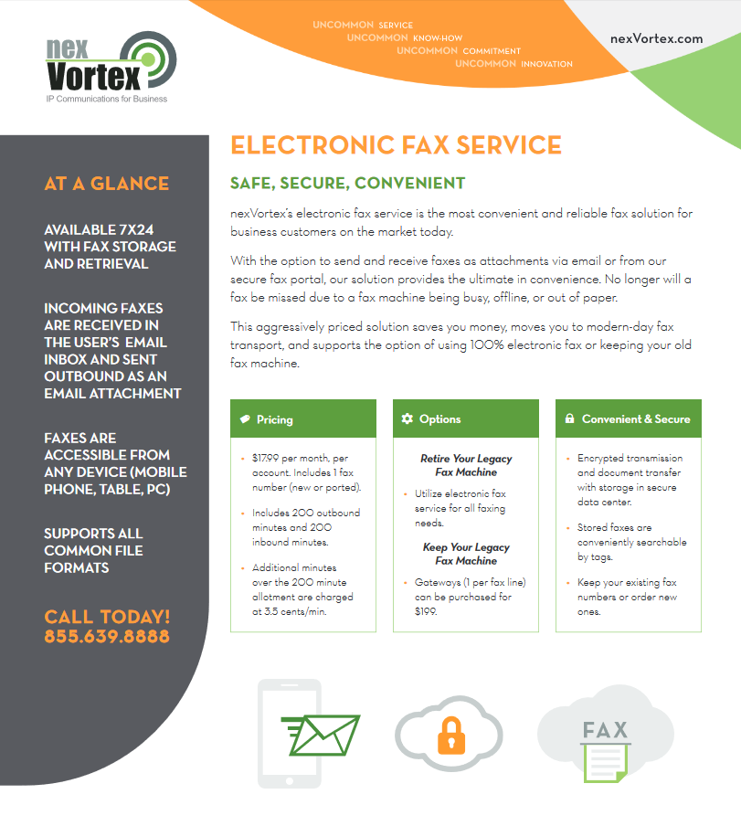
Electronic Fax – nV Fax
nexVortex nVFax Options
Electronic Fax(Does not use VOIP)
Electronic Fax with Conversion for existing Fax Machine Integration
$17.99 per line per month
Month to Month Service
Fax Bridge Gateway is Optional

